Slide 1

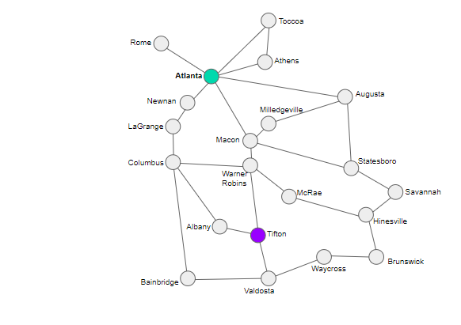
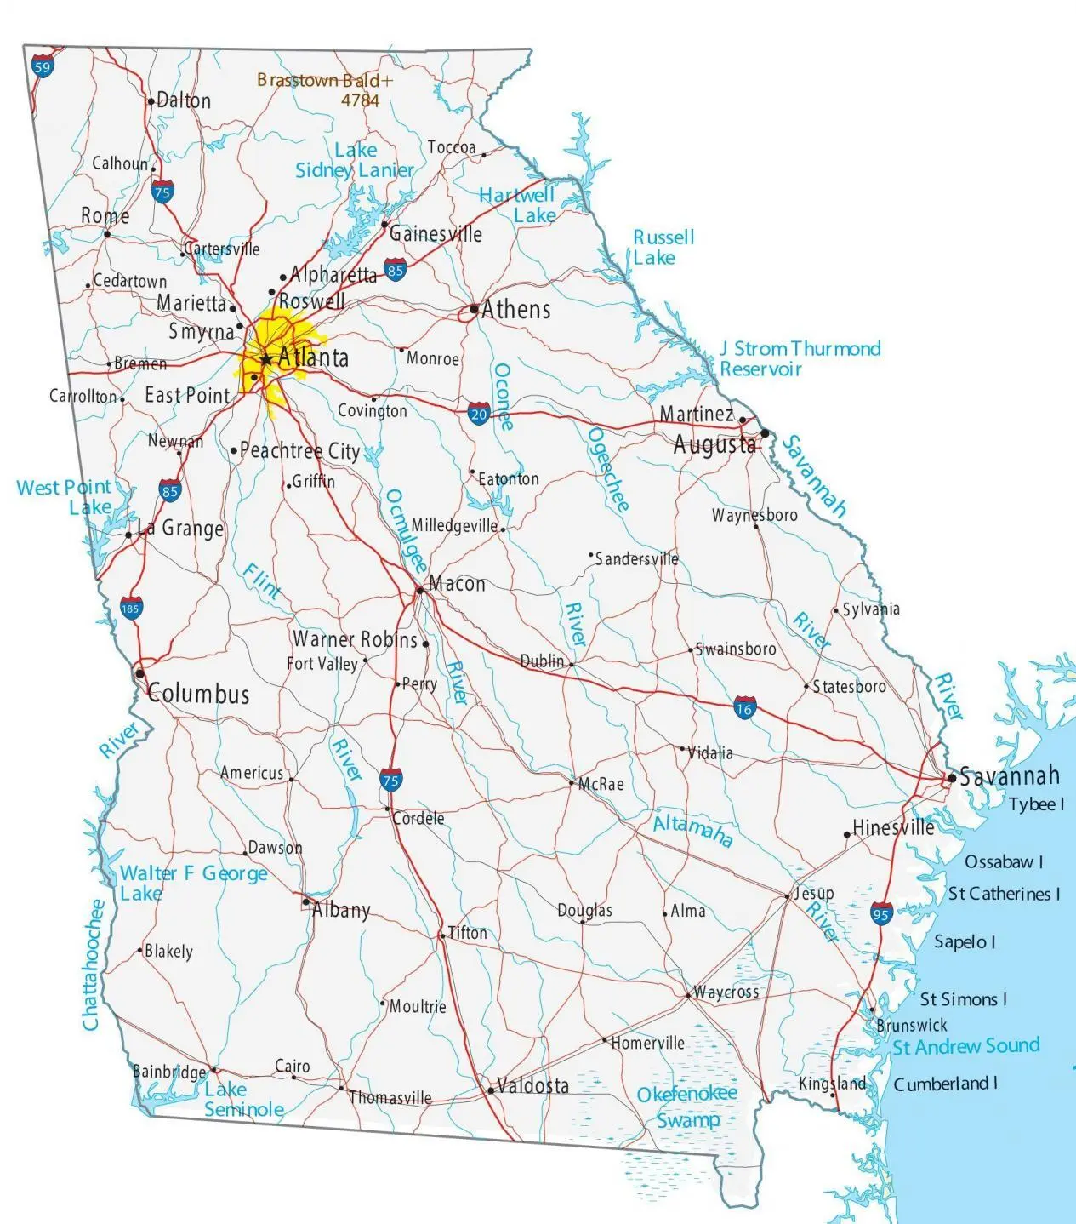

Module 1.5
Route Finding
Living and Working with Artificial Intelligence
Find a route from Atlanta to Tifton
Developed for the AI4GA (Artificial Intelligence for Georgia) project funded by National Science Foundation awards DRL-2049029 and DRL-2048502.
This work is licensed under the Creative Commons Attribution-NonCommercial-ShareAlike 4.0 International License. https://creativecommons.org/licenses/by-nc-sa/4.0/

Slide 2
Warm-up Questions

Slide 3
Warm-up Question
How do autonomous robots and self-driving cars find their way through the world?

Slide 4
Autonomous robots and self-driving cars make and use maps of their worlds

Slide 5
Personal Connection:
What kinds of maps have
you used in the past?
Notes:
Let the students provide some examples.
Then click through the next few slides and show them maps with different representations and of different locations

Slide 6
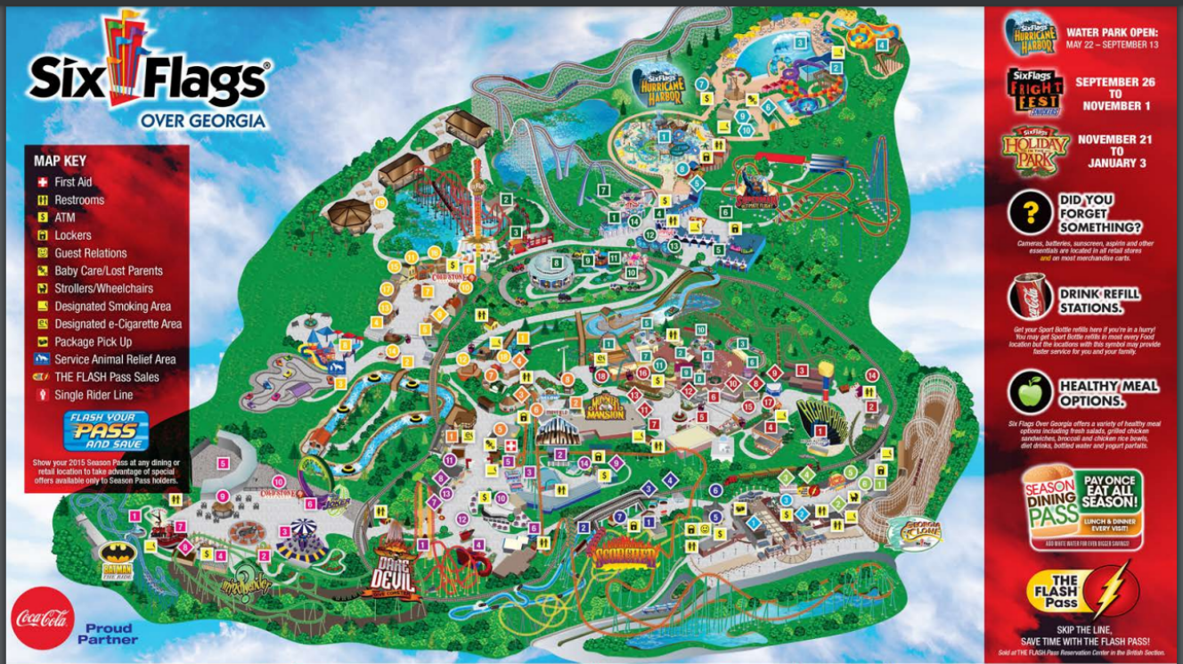
Notes:
Take Away - levels of representation
Here is a map of Six Flags over Georgia, What kinds of things have they chosen to represent and how?
This map tries to reflect the geographical features of the amusement park as well as key places a person might want to know about: Bathrooms, major rides, places to eat
Instead of adding names for each location, they label them with numbers.
They have also labeled major park areas using colors.
How would you give instructions to a person using this map?
Link to Source with key - https://www.sixflags.com/sites/default/files/sfog_fullmap.pdf

Slide 7
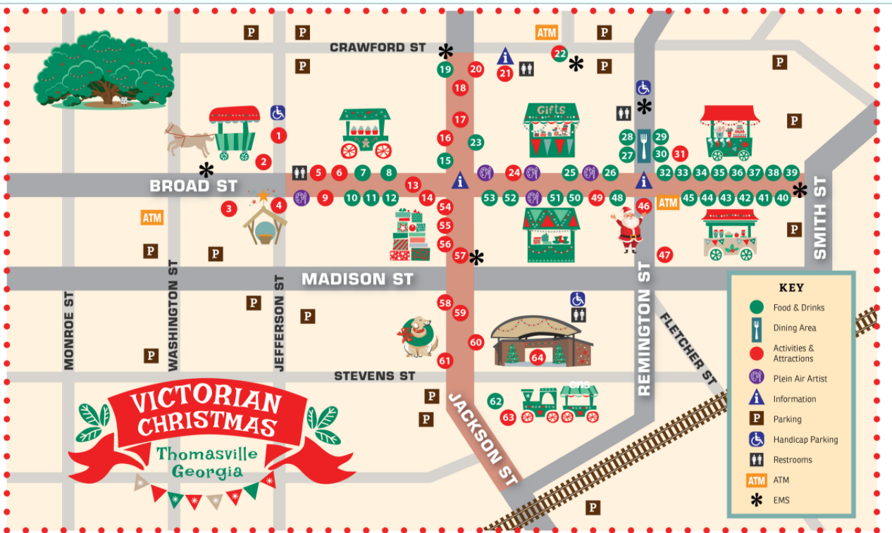
Notes:
Let’s look at another map, this one is of downtown Thomasville, GA.
Pre-pandemic, they help their annual Victorian Christmas festival.
What do you notice about this map? What key things did the map designer chose to represent?
Street names
Major festival activity path in brown
Major landmarks (big tree and railroad)
Key festival activities - nativity scene, christmas tree, train ride,
Key festival booths/stations
How would you give directions using this map?
Link to Source with key - https://thomasvillega.com/uploads/groups/3/Attractions/Festivals/Victorian%20Christmas/Small-Map-Final.jpg

Slide 8
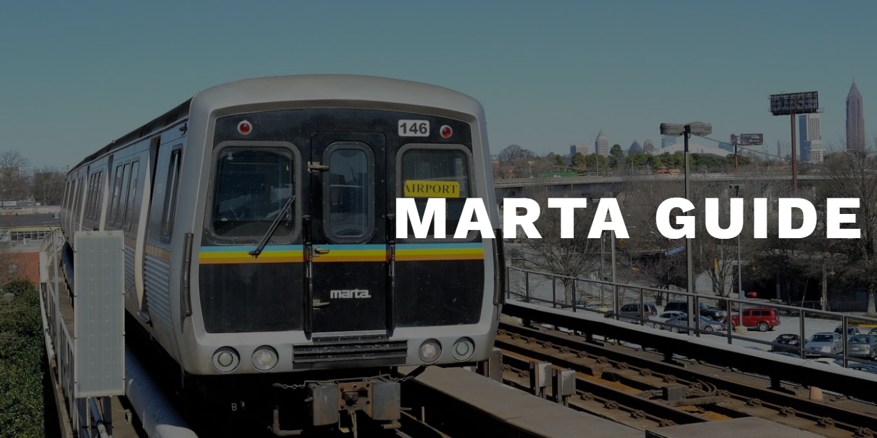
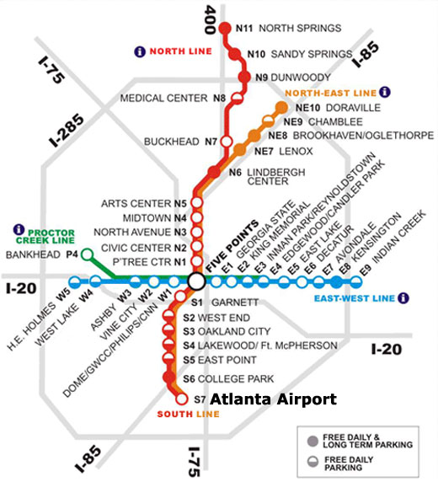
Notes:
This is a map of the Marta train in Atlanta.

Slide 9
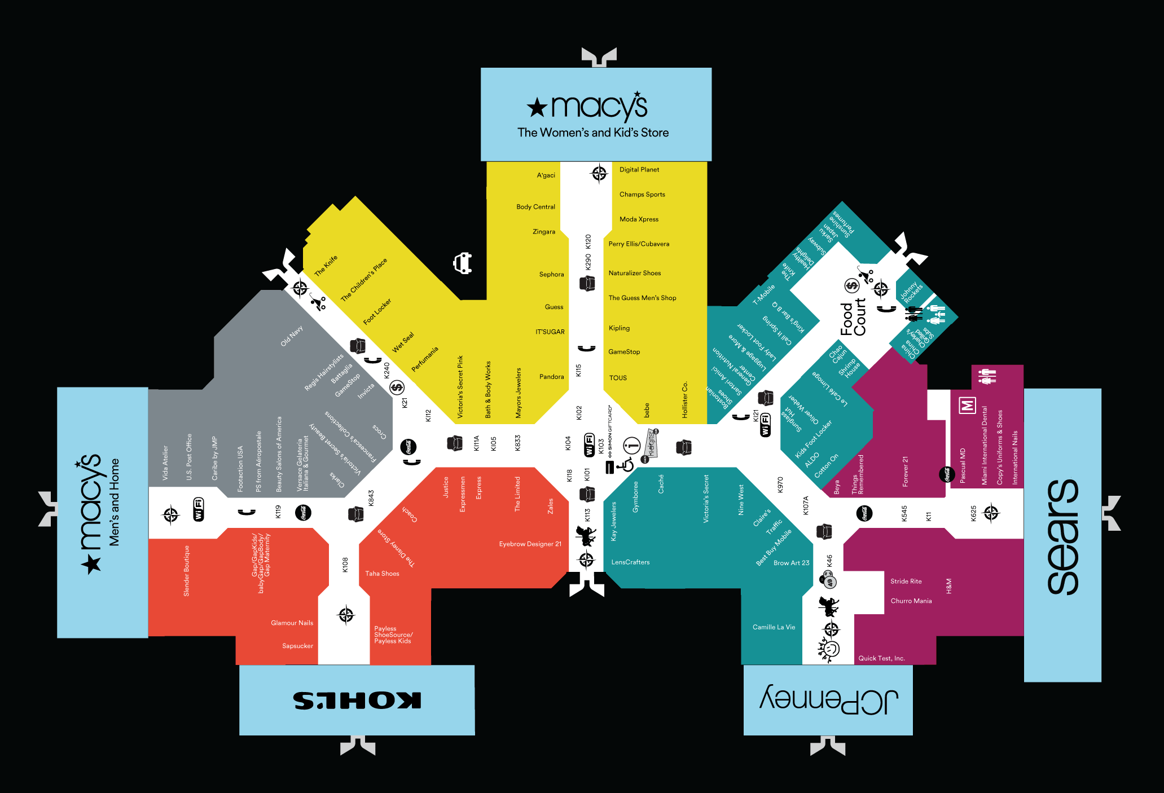
Finding paths through the mall

Slide 10
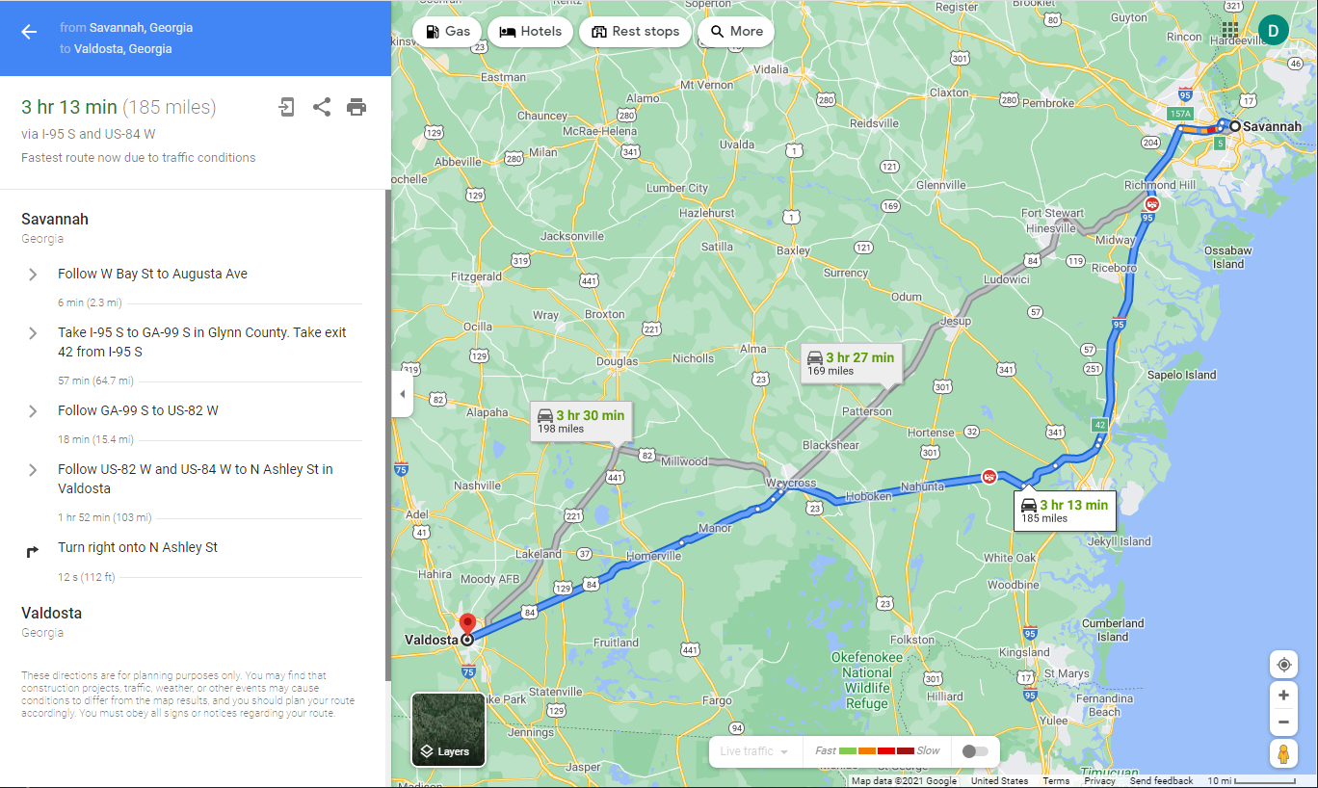
How does a self-driving car know which route to follow?
Map of Georgia
How does Google Maps create directions for you?

Slide 11
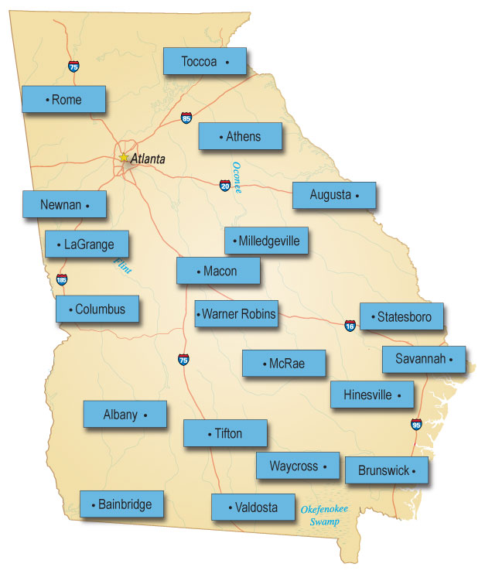
Let’s create a representation a computer could use.
It’s called a “graph”.
For each city, we’ll add a blue label and type the city name.
Label for each city
Notes:
Let’s identify some key cities in Georgia and label them on the map in blue.

Slide 12
For each city, we now need to add a node
Node - represents the location for each city
Notes:
Now, let’s add nodes representing the location of the selected cities, we’ll place the nodes next to their labels

Slide 13
Now, we need to represent the roads that connect the cities, we’ll use:
links - represent the roads connecting cities
Links connect nodes together
Notes:
Last, we need need to create links between these node (cities) represent roads that connect the cities.

Slide 14
Georgia cities graph
Toccoa
Route finding is
a graph search
problem.
Rome
Athens
Atlanta
Newnan
Augusta
Milledgeville
LaGrange
Macon
Columbus
Statesboro
Warner Robins
McRae
Savannah
Albany
Hinesville
Tifton
Waycross
Brunswick
Bainbridge
Valdosta
Notes:
Now we have our completed graph with nodes representing each city and their labels, and link representing the roads that connect them.

Slide 15
Breadth-First Search
Today we will learn an algorithm called the “breadth-first search”.
Breadth-First means at each level, we examine all the neighboring cities to the ones just reached, before proceeding to the next level. We keep going until we reach our destination.

Slide 16
Breadth-First Search (Using Colors)
Toccoa
Rome
Athens
Atlanta
Augusta
Color the starting city as level 0.
Find all the uncolored neighbors, and
color them using the next level’s color.
Repeat step 2 until you’ve colored
the destination city.
Newnan
Milledgeville
LaGrange
Macon
Columbus
Statesboro
Warner Robins
McRae
Savannah
Albany
Hinesville
Tifton
Waycross
Brunswick
Level 0
Level 1
Level 2
Level 3
Level 4
Bainbridge
Valdosta

Slide 17
How to get from Savannah to Valdosta: Level 0
Toccoa
Color our start city:
Savannah is level 0.
Rome
Athens
Level 0
Atlanta
Newnan
Augusta
Milledgeville
LaGrange
Macon
Columbus
Statesboro
Warner Robins
McRae
Savannah
Albany
Hinesville
Tifton
Waycross
Brunswick
Bainbridge
Valdosta
Which cities will be cities?
Level 1

Slide 18
How to get from Savannah to Valdosta: Level 1
Toccoa
Color the cities reachable from Savannah as level 1.
Rome
Athens
Level 0
Atlanta
Augusta
Level 1
Newnan
Milledgeville
LaGrange
Macon
Columbus
Statesboro
Warner Robins
McRae
Savannah
Albany
Hinesville
Tifton
Waycross
Brunswick
Bainbridge
Valdosta
Which cities will be cities?
Level 2

Slide 19
How to get from Savannah to Valdosta: Level 2
Toccoa
Color the uncolored neighbors of level 1 cities as level 2.
Rome
Athens
Level 0
Atlanta
Augusta
Level 1
Newnan
Milledgeville
LaGrange
Level 2
Macon
Columbus
Statesboro
Warner Robins
McRae
Savannah
Albany
Hinesville
Tifton
Waycross
Brunswick
Bainbridge
Valdosta
Which cities will be cities?
Level 3

Slide 20
How to get from Savannah to Valdosta: Level 3
Toccoa
Color the uncolored neighbors of level 2 cities as level 3.
Rome
Athens
Level 0
Atlanta
Augusta
Level 1
Newnan
Milledgeville
LaGrange
Level 2
Macon
Columbus
Statesboro
Level 3
Warner Robins
McRae
Savannah
Albany
Hinesville
Tifton
Waycross
Brunswick
Bainbridge
Valdosta
Which cities will be cities?
Level 4

Slide 21
How to get from Savannah to Valdosta: Level 4
Toccoa
Color the uncolored neighbors of level 3 cities as level 4.
This includes our destination city, Valdosta.
Yay!
Rome
Athens
Level 0
Atlanta
Augusta
Level 1
Newnan
Milledgeville
LaGrange
Level 2
Macon
Columbus
Statesboro
Level 3
Warner Robins
McRae
Savannah
Level 4
Albany
Hinesville
Tifton
Waycross
Brunswick
Bainbridge
Valdosta
There are still some cities left uncolored. Do we need to go to level 5?

Slide 22
How do you recover the solution path?
Level 0
Level 1
Toccoa
Level 2
Start at the goal: Valdosta. It is at level 4. Write down the label of that node.
Find a neighbor one level below. Write down its label and move to that node.
Repeat step 2 until you reach the starting point (Savannah), at level 0.
Athens
Level 3
Augusta
Milledgeville
Level 4
LaGrange
Columbus
Statesboro
Warner Robins
McRae
Savannah
Albany
Hinesville
Tifton
Waycross
Brunswick
Bainbridge
Valdosta

Slide 23
Recovering the solution path
Toccoa
Begin at the
destination (Valdosta) and work backwards
toward the start (Savannah).
Then reverse the result.
Rome
Level 0
Athens
Level 0
Atlanta
Level 1
Augusta
Level 1
Newnan
Milledgeville
Level 2
LaGrange
Level 2
Macon
Statesboro
Level 3
Columbus
Level 3
Warner Robins
McRae
Savannah
Level 4
Level 4
Albany
Hinesville
Tifton
Waycross
Brunswick
Bainbridge
Valdosta

Slide 24
Often Forget to Recover the solution path
Toccoa
Begin at the
destination (Valdosta) and work backwards (decreasing the levels)
toward the start (Savannah).
Then reverse the result.
Rome
Level 0
Athens
Level 0
Atlanta
Level 1
Augusta
Level 1
Newnan
Milledgeville
Level 2
LaGrange
Level 2
Macon
Statesboro
Level 3
Columbus
Level 3
Warner Robins
McRae
Savannah
Level 4
Level 4
Albany
Hinesville
Tifton
Backward path
Forward Path
Waycross
Brunswick
Bainbridge
Valdosta
Savannah
Hinesville
Brunswick
Waycross
Valdosta
Notes:
Computers can't see the map. The computer doesn't have spatial intuition in this algorithm.
Work backward each level.

Slide 25

ACTIVITY TIME

Slide 26
Worksheet Page 1: Columbus to Brunswick
Toccoa
ork with your partner. Try to color all of the appropriate nodes from Columbus to Brunswick. Remember: You want to color the neighboring cities one step at a time.
Pro-tip: Place your finger on first city. Trace the lines that leave the city. Those are the neighbors. This helps you not to miss any cities.
Rome
Athens
Level 0
Atlanta
Augusta
Level 1
Newnan
Milledgeville
LaGrange
Level 2
Macon
Columbus
Statesboro
Level 3
Warner Robins
McRae
Savannah
Level 4
Albany
Hinesville
Tifton
Waycross
Brunswick
Bainbridge
Valdosta

Slide 27
Exercise: Columbus to Brunswick
Toccoa
Once you have finished coloring the nodes, you can trace backwards from the destination. Recover the solution!
Pro-tip: Be sure you do NOT repeat any colors when you trace for a solution.
Rome
Athens
Level 0
Atlanta
Augusta
Level 1
Newnan
Milledgeville
LaGrange
Level 2
Macon
Columbus
Statesboro
Level 3
Warner Robins
McRae
Savannah
Level 4
Albany
Hinesville
Tifton
Waycross
Brunswick
Bainbridge
Valdosta

Slide 28
Solutions: Columbus to Brunswick
Toccoa
There are two solutions.
The choice is arbitrary.
Rome
Athens
Level 0
Atlanta
Augusta
Level 1
Newnan
Milledgeville
LaGrange
Level 2
Macon
Columbus
Statesboro
Level 3
Warner Robins
McRae
Savannah
Level 4
Albany
Hinesville
Tifton
Waycross
Brunswick
Bainbridge
Valdosta

Slide 29
So let’s break down the Breadth-First Search Algorithm into steps
AI4K12 Guideline 2-B-ii
Make the starting city the root of the search tree (level 0).
For every node at the current level:
  Find its neighbors that are not already in the tree.
  Add those neighbors to the next level of the tree.
  If one of the neighbors is the destination, exit.
Repeat step 2 for the next level of the tree.

Slide 30
Reflection:
Describe how to conduct a breadth-first search
Notes:
Let the students provide some examples.
Then click through the next few slides and show them maps with different representations and of different locations

Slide 32
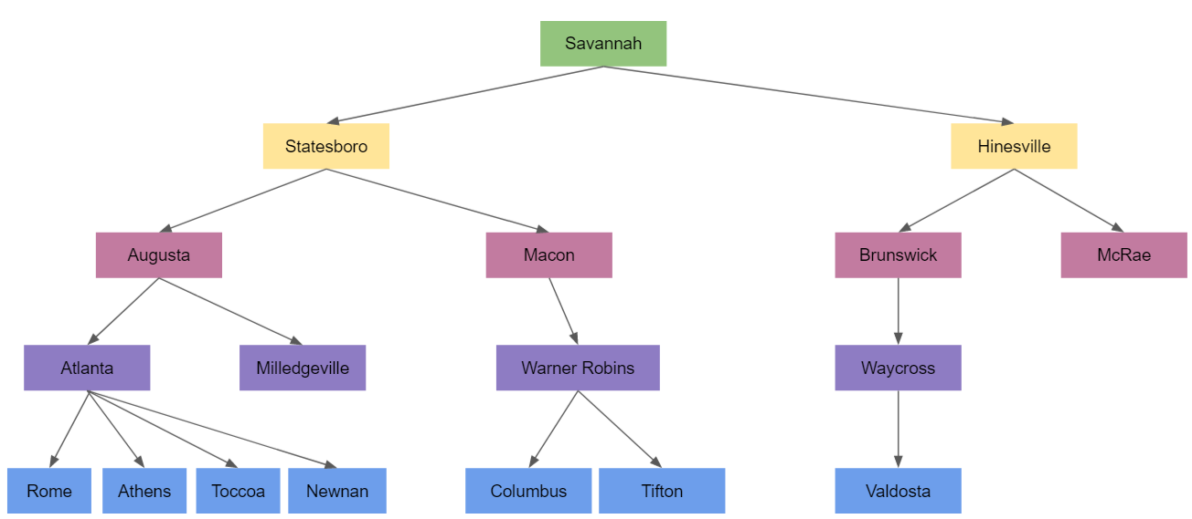
Breadth-First Search: Search Tree
Fun Fact: Breadth-first search can be used even when we don’t have a graph to color.
The algorithms works by constructing a search tree.

Slide 33
Let’s draw a search tree to find a route from Savannah to Valdosta
Toccoa
Let’s locate on the map
Savannah
Valdosta
Rome
Athens
Atlanta
Newnan
Augusta
Milledgeville
LaGrange
Macon
Columbus
Statesboro
Warner Robins
McRae
Savannah
Albany
Hinesville
Tifton
Waycross
Brunswick
Bainbridge
Valdosta
Notes:
Some interesting things to note about the “Atlanta to Warner Robins” problem. Atlanta has roads going off in all directions, so it emphasizes the fact that the algorithm has no idea which way to proceed; it has to try all possible paths. Also note that both Athens and Toccoa are directly reachable from Atlanta, so they will end up with the same color; the fact that there is a road from Athens to Toccoa doesn’t matter because Toccoa has already been colored by the time we start looking at Athens’ neighbors.

Slide 34
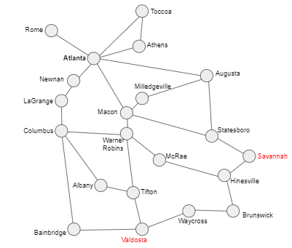
Breadth-First Search: Savannah to Valdosta
Step 1:
Make the starting city the root of the search tree (level 0).
Tree Root
Savannah

Slide 35
Breadth-First Search: Savannah to Valdosta
Current level
Step 2: For every node at the current level:
  Find its neighbors that are not already in the tree.
  Add those neighbors to the next level of the tree.
  If one of the neighbors is the destination, exit.
What cities neighbor Savannah?
Savannah

Slide 36
Breadth-First Search: Savannah to Valdosta
Current level
Savannah
Statesboro
Hinesville
Step 2: For every node at the current level:
  Find its neighbors that are not already in the tree.
  Add those neighbors to the next level of the tree.
  If one of the neighbors is the destination, exit.
Are we at our destination?

Slide 37
Breadth-First Search: Savannah to Valdosta
Savannah
Statesboro
Hinesville
Step 3: For every node at the current level:
  Find its neighbors that are not already in the tree.
  Add those neighbors to the next level of the tree.
  If one of the neighbors is the destination, exit.

Slide 38
Breadth-First Search: Savannah to Valdosta
Savannah
Statesboro
Hinesville
Augusta
Macon
Brunswick
McRae
What should we do next?
(Repeat the process again.)
Are we at our destination?

Slide 39
Breadth-First Search: Savannah to Valdosta
Savannah
Statesboro
Hinesville
Augusta
Macon
Brunswick
McRae
Atlanta
Milledgeville
Warner Robins
Waycross
Are we at our destination?

Slide 40
Breadth-First Search: Savannah to Valdosta
Savannah
Statesboro
Hinesville
Augusta
Macon
Brunswick
McRae
Atlanta
Milledgeville
Warner Robins
Waycross
Rome
Athens
Toccoa
Newnan
Columbus
Tifton
Valdosta
Are we at our destination?

Slide 41
Breadth-First Search: Savannah to Valdosta
Recovering the Solution Path
Savannah
Statesboro
Hinesville
Augusta
Macon
Brunswick
McRae
Atlanta
Milledgeville
Warner Robins
Waycross
Rome
Athens
Toccoa
Newnan
Columbus
Tifton
Valdosta

Slide 42
You try it:
Draw the search tree
Toccoa
Find a route from
Atlanta to
Warner Robins
Rome
Athens
Level 0
Atlanta
Augusta
Level 1
Newnan
Milledgeville
LaGrange
Level 2
Macon
Columbus
Statesboro
Level 3
Warner Robins
McRae
Savannah
Level 4
Albany
Hinesville
Tifton
Waycross
Brunswick
Bainbridge
Valdosta
Notes:
Some interesting things to note about the “Atlanta to Warner Robins” problem. Atlanta has roads going off in all directions, so it emphasizes the fact that the algorithm has no idea which way to proceed; it has to try all possible paths. Also note that both Athens and Toccoa are directly reachable from Atlanta, so they will end up with the same color; the fact that there is a road from Athens to Toccoa doesn’t matter because Toccoa has already been colored by the time we start looking at Athens’ neighbors.

Slide 43
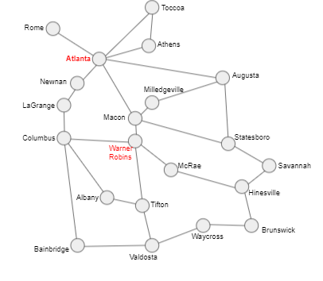
Breadth-First Search: Atlanta to Warner Robins
Recovering the Solution Path
Atlanta
Athens
Toccoa
Rome
Agusta
Newnan
Macon
Milledegeville
Statesboro
Legrange
Warner Robins
Route/Path
Atlanta
Macon
Warner Robins

Slide 45
Recap
TPS - summarize what you learned today

Slide 46
Recap
So far we’ve talked about maps and their representations, and an algorithm
that a self-driving car might use to navigate from one location to another.
We used labels, nodes, and links to create a graph of the state. Then used the breadth first search method to find a route from a starting location to a destination.

Slide 48
Other than a map for driving around a state, can you think of other kinds of maps a self-driving car or autonomous robot might create for themselves?

Slide 49
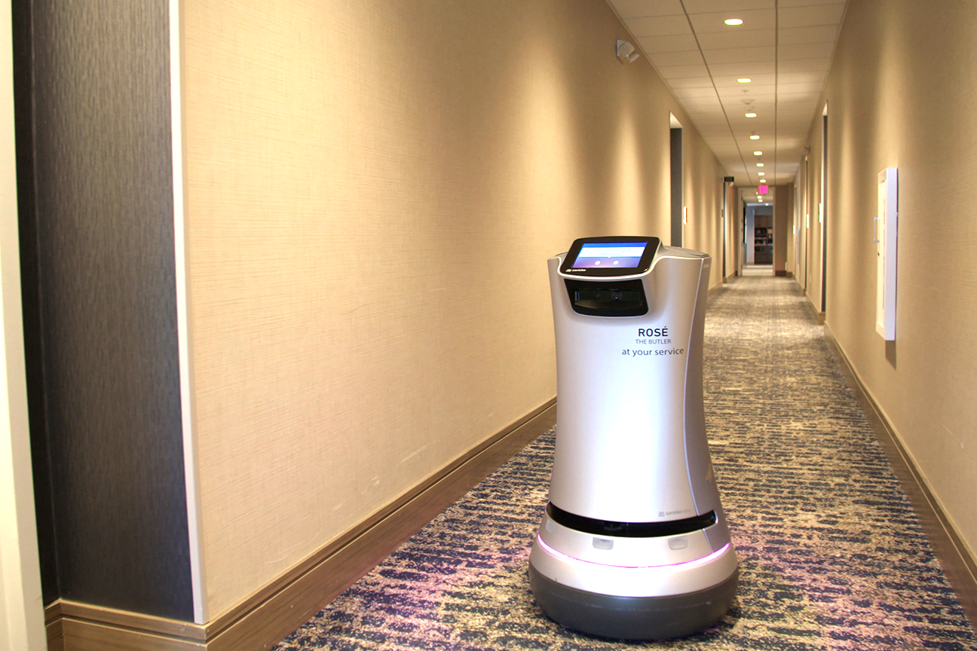

Other Applications for Route Finding
Autonomous robots might be given a map of a hotel, hospital, or warehouse.
Robot vacuum cleaners create a map of the home and you can use an app to see the map and adjust it.

Slide 50

Assessment:
Help Bloopaloop Junior Travel from Hinesville to Atlanta
Toccoa
Let’s locate on the map
Hinesville to Atlanta
Rome
Atlanta
Athens
Newnan
Augusta
Milledgeville
LaGrange
Macon
Columbus
Statesboro
Warner Robins
McRae
Savannah
Albany
Hinesville
Tifton
Waycross
Brunswick
Bainbridge
Valdosta

Slide 51
My Dream Bot
Over the course of Unit 1, you will design your own dream robot.

Slide 52
Module 1.5: Route Finding
Tip: Students should complete in their own Dream Bot slides
Imagine you robot needs to move.
How might your robot use “route finding”?
What map would your robot need to know or discover?
How would your robot find the best route? (pre-determined, breadth-first, etc)

Slide 53
Module 1.6: Societal Impact
Tip: Students should complete in their own Dream Bot slides
What are some concerns people might have about your robot’s impact on society?
What are some aspects of your robot (or things you could add to it) that would have positive impacts on society?
What type of work places or locations (industries) might be interested in using your robots?

